Slide 1
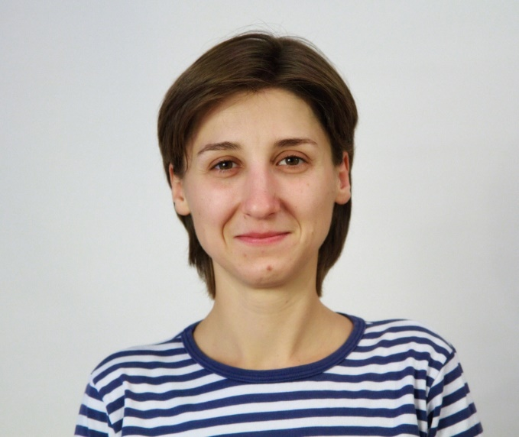

International i-Tree Academy i-Tree Action Plan
Oleksandra Khalaim
Kyiv & Ukraine
NGO UEC Green Wave
Your Photo
1.Briefly state the objective for your i-Tree Action Plan
2. What issue(s) or opportunity will your plan help address?
3. What i-Tree tool(s) do you plan to use?
To create analytical and technological prerequisites for launching an interactive, participatory, and transparent inventory system of Kyiv urban trees by local authorities and public activists, in order to raise the city's adaptability to climate change negative impacts.
Urban trees inventory challenges (frequency, technology, costs)
Public awareness & involvement
Data access; decision-making quality & transparency
Climate change negative impacts (heat waves/heat islands)
i-Tree Canopy
i-Tree Eco
i-Tree Database

Slide 2
Briefly describe planned actions or next steps
Who are key partners?
What resources are needed?
What obstacles, challenges do you anticipate?
State-of-the-art analysis (urban green zones inventory related legislation requirements, management structure, current state and problems in Kyiv and Ukraine) ⇒ January-February 2021;
Pilot inventory preparation (plots selection, estimation of data availability, and training for volunteers) ⇒ February 2021;
Pilot inventory field work at two selected plots, engaging local stakeholders ⇒ March 2021;
Policy brief development and results presentation at the press conference ⇒ April 2021.
Public Utility Company “Kyivzelenbud”, ecology dept of Kyiv City Council
Kyiv universities (tbc)
NGO “Ecopark Osokorky” https://ecopark-osokorky.com.ua/en/
International Renaissance Foundation https://www.irf.ua/en/about/
Partner cooperation with the local stakeholders
Hourly climate data - will be derived from https://rp5.ua/Weather_archive
Equipment and volunteers for the field work
Funding - provided by IRF under the GA #SG53946
Pandemic related restrictions for the field work
Low public awareness and stakeholders’ engagement

Slide 3
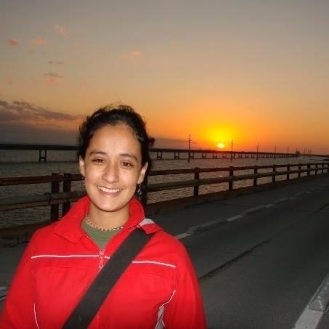
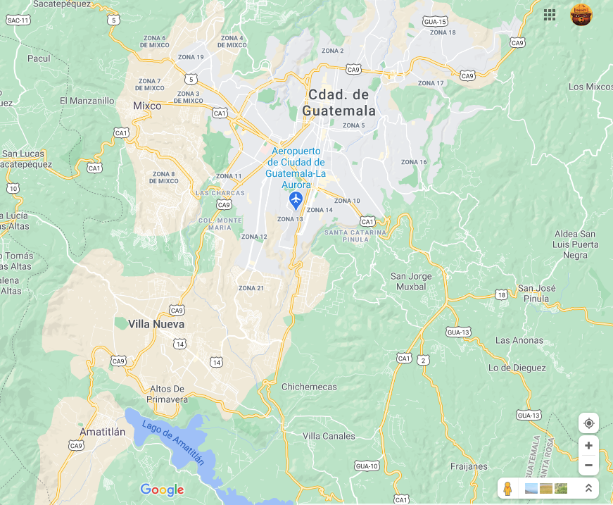
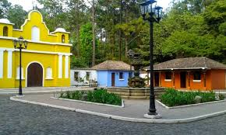
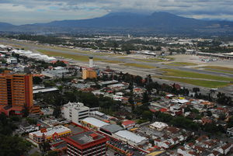
International i-Tree Academy i-Tree Action Plan
Lucrecia Masaya
Guatemala City
Guatemala
USFS IP
Your Photo
1.Main obj: Adapt i-Tree to Guatemala.
Specific obj:
*Compare 2 areas (National Park) and Zone 13.
*Develop educational and citizen science programs.
2. Citizens are unaware of ecosystem services provided by urban trees and ravines are not protected by the city.
3. We will use i-Tree Canopy, Database and Eco
United Nations National Park
Images or Support content
Zone 13

Slide 4
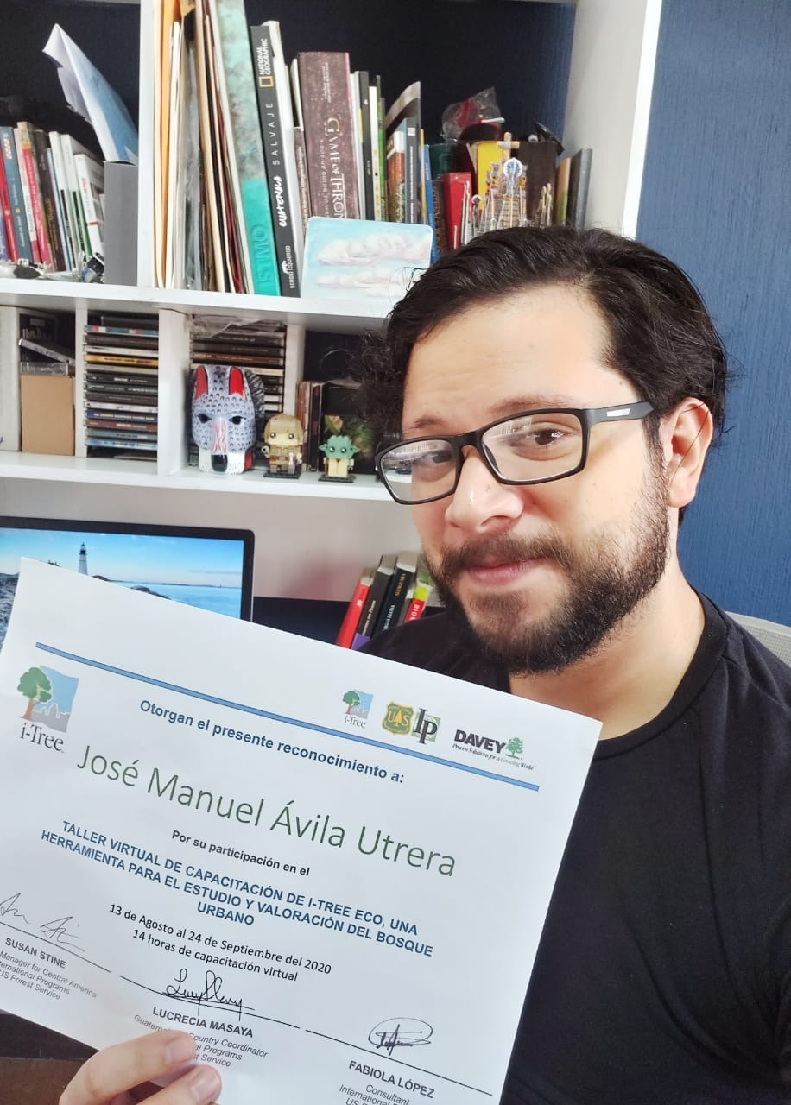








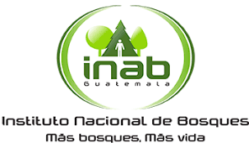



Next steps: USFS IP created committees, we will upload data in i-Tree Database and make an action plan
Partners: NGOs, Academia, Government agencies
Requirements:
Crews for field work
Training sessions -Fuel
Meals
Field guides
Field equipment
Obstacles: Data availability, crews are volunteers, crews safety, emergencies such as wildfires.
USFS IP conducted i-Tree Eco training program
Our partners:

Slide 5
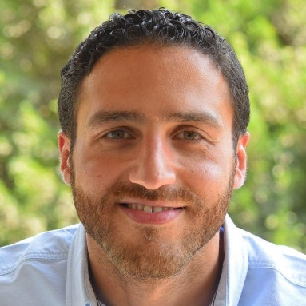
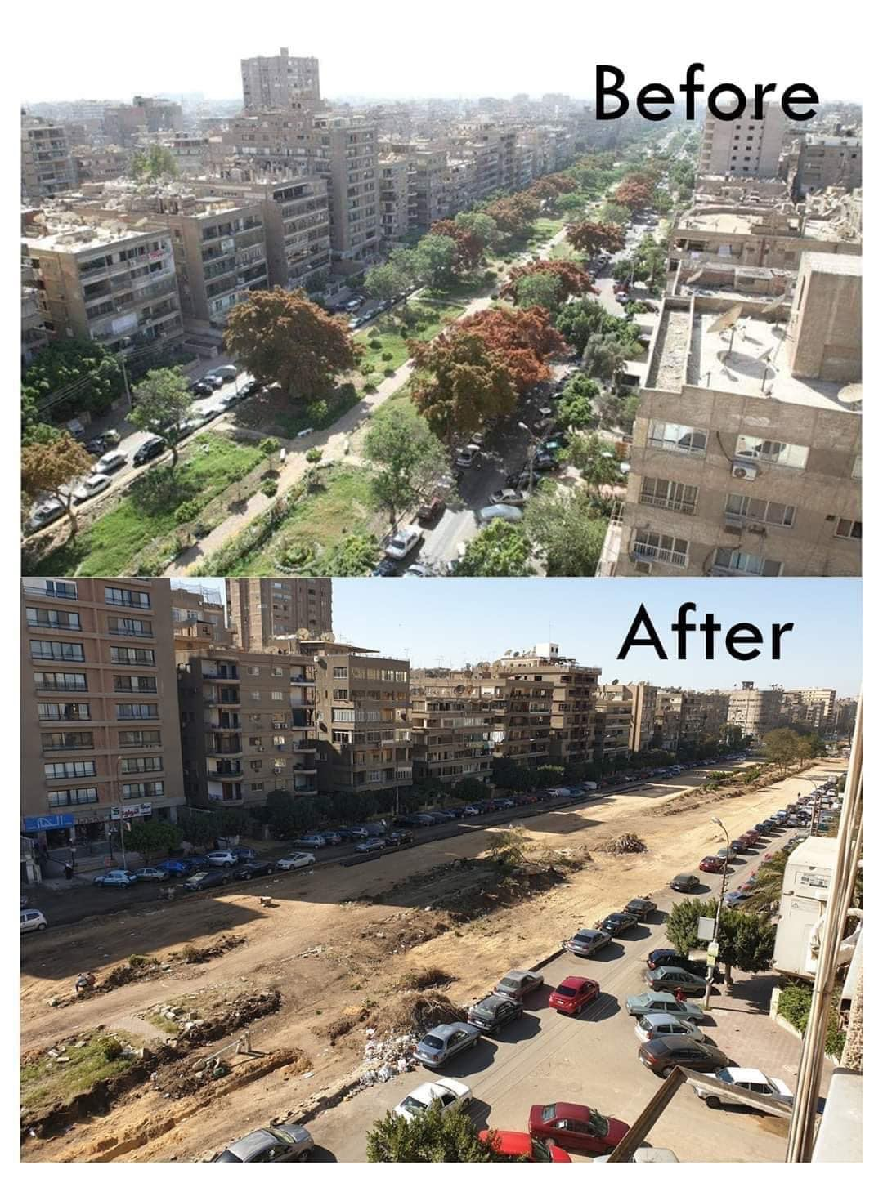
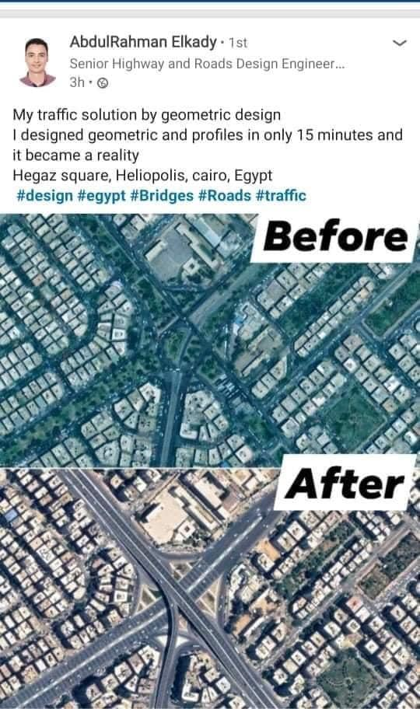
International i-Tree Academy i-Tree Action Plan
Abdallah Tawfic
Cairo, Egypt
Urban Greens Egypt
Your Photo
1.Briefly state the objective for your i-Tree Action Plan or i-Tree project idea.
My objective is to identify and analyze the value of trees lost in Heliopolis Neighborhood in Cairo during the past 5 years (using historical assessment) due to governmental approach to solve traffic issues, and use such data to raise awareness about the benefits and importance of urban trees and green spaces (different layers of target groups).
2. What issue(s) or opportunity will your plan help address?
- Lack of green spaces/trees in Cairo
Change the local mindset into realizing the potential/value of trees
Change the decision makers perspective towards their approach “ grey urban transformation”
3. What i-Tree tool(s) do you plan to use?
I tree Canopy
Images or Support content

Slide 6
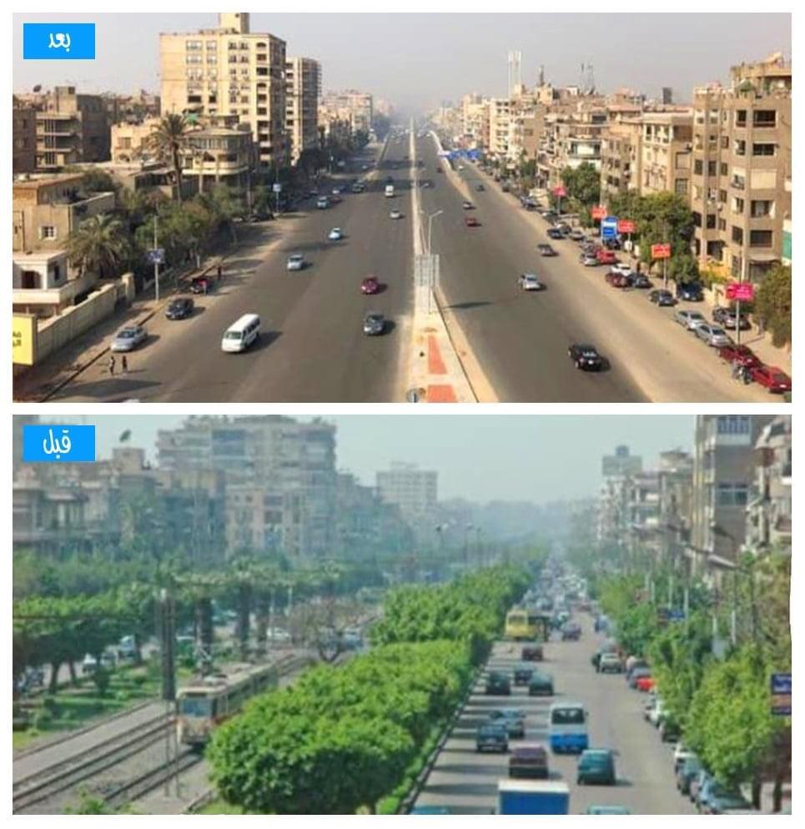
Briefly describe planned actions or next steps
1- Identify the focus area (baseline data)
2- data collection
3-project setup
4- Processing, results, analysis and reporting
Who are key partners?
- Local district representatives
- Active Members of different Heliopolis communities ( social clubs – rotary Heliopolis – activists- influencers..etc)
- Academics interested in supporting in/expanding the model
What resources are needed?
-Google Earth /images of the neighborhood throughout the transformation phase
-Maps/drawings of the recent development
What obstacles, challenges do you anticipate?
Lack of data (types of trees..etc.)
Local authorities not willing to collaborate in sharing information (if needed)
Unclear aerial images before development

