Slide 1
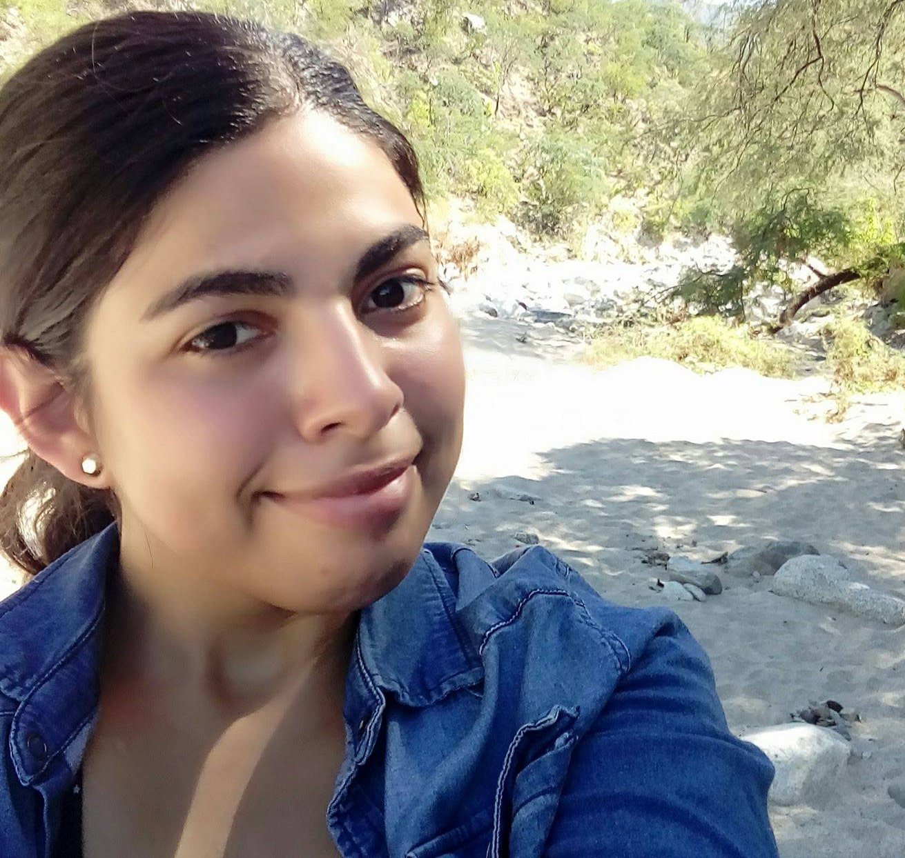
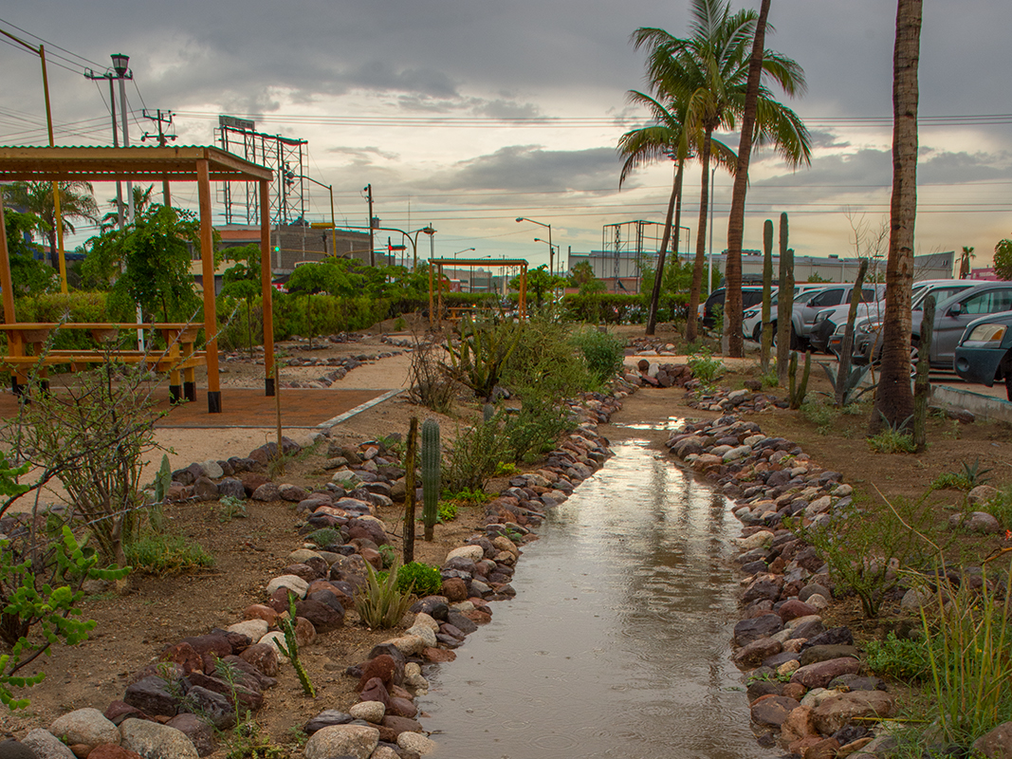
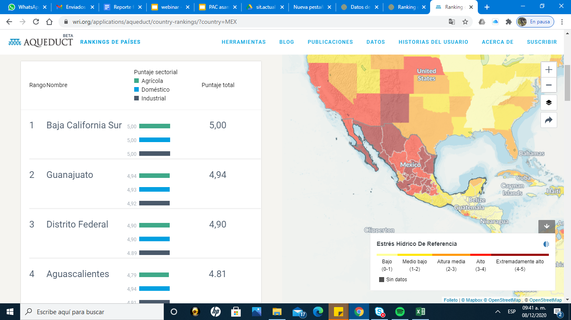
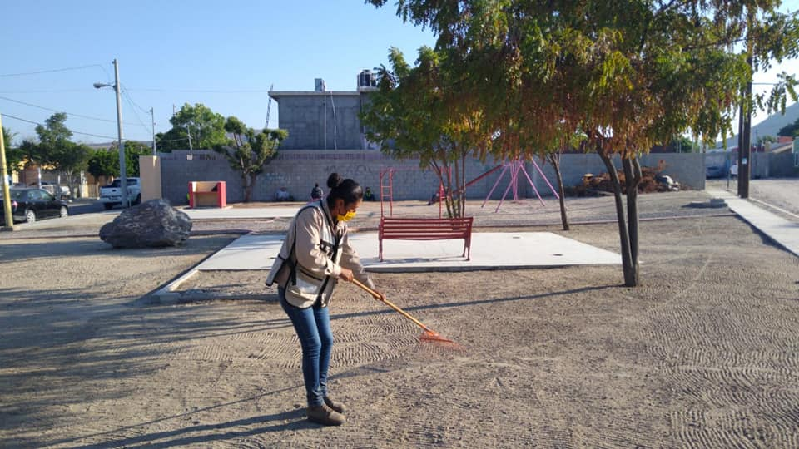
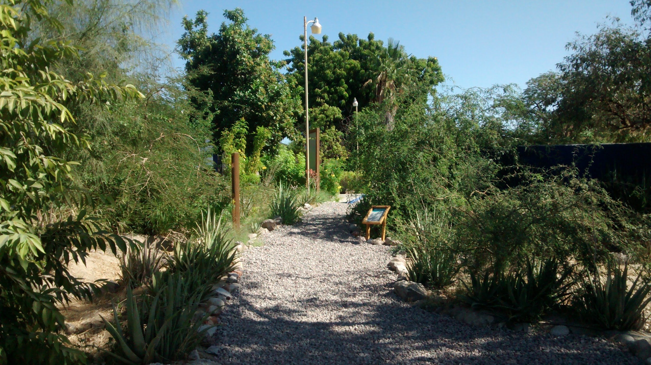
International i-Tree Academy i-Tree Action Plan
Measuring the benefits of Urban Oases
Nicole Harmelin
La Paz, Mexico
Niparajá A.C.
Objective:
  Find potential areas for new urban oases
  Have monitoring indicators and impact of native vegetation in urban oases,
  Promote importance and benefits of native vegetation in the urban area.
Issue(s) or opportunity will this plan help address:
Increase the creation of green spaces, promote their importance and have indicators that demonstrate their benefits
i-Tree tools:
  I-Tree canopy
  I-Tree Data Base
  I-Tree Eco

Slide 2
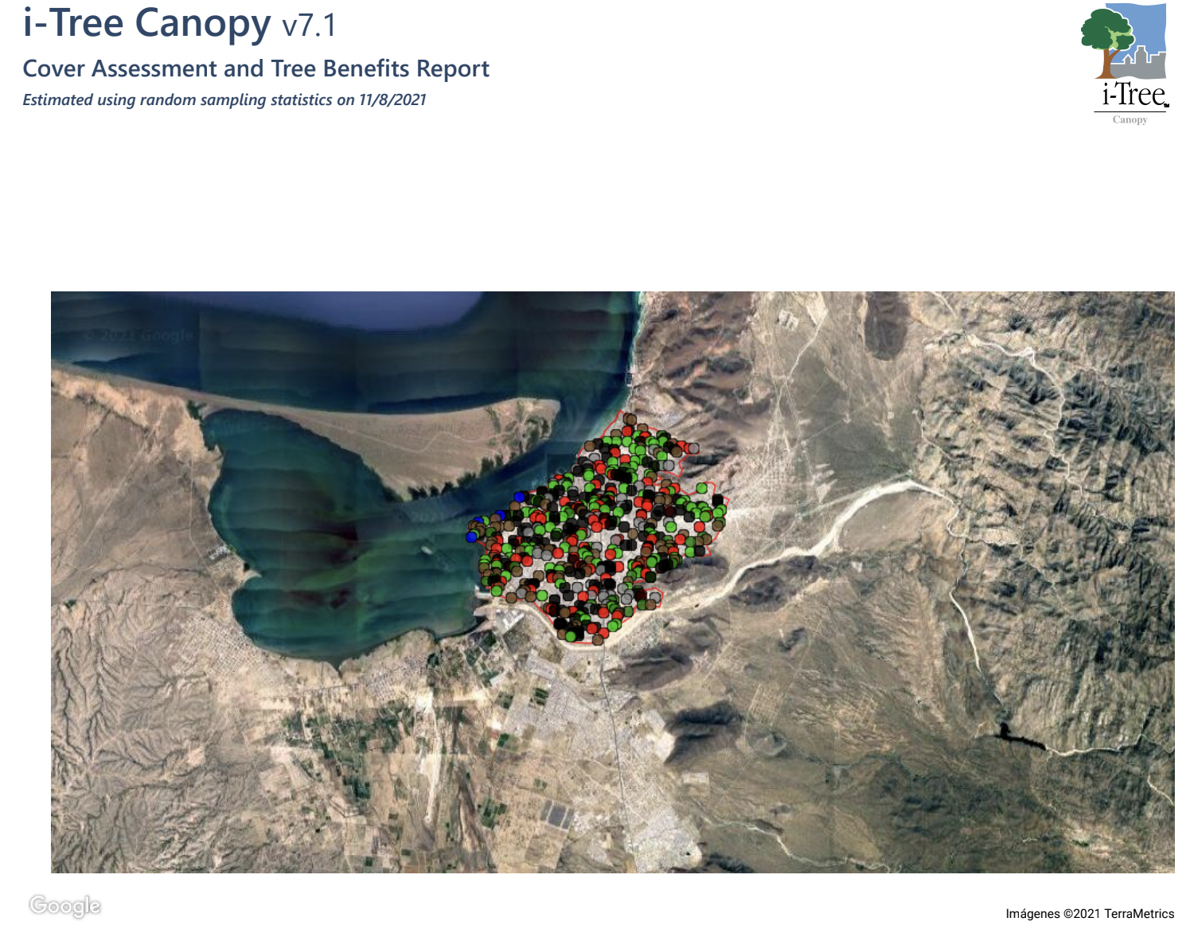
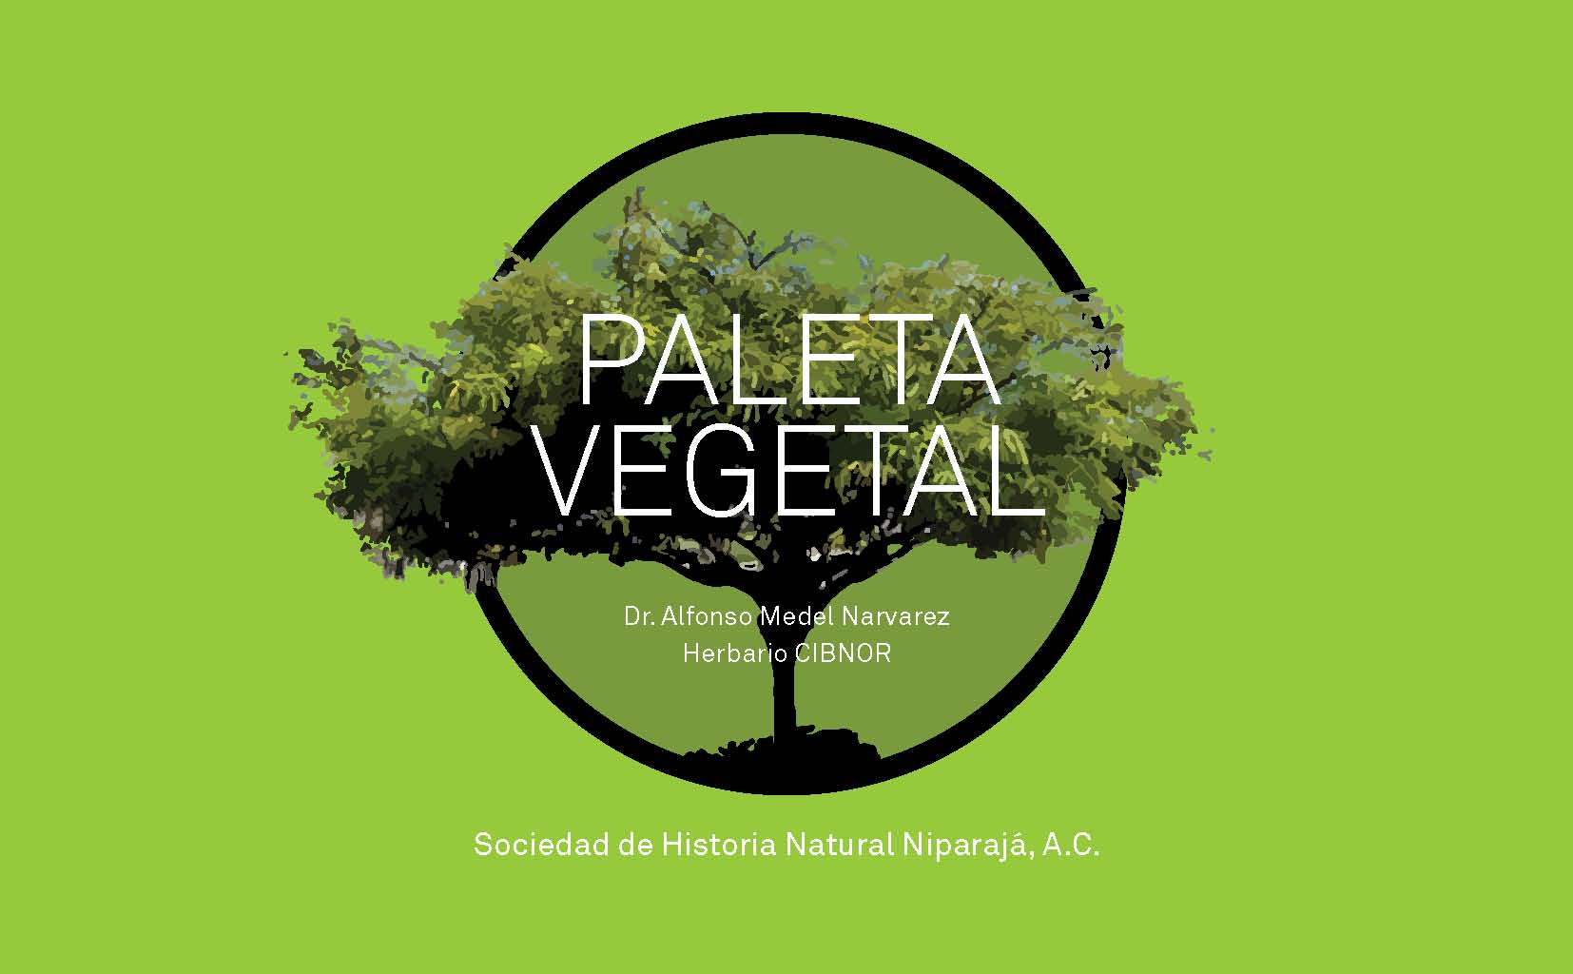
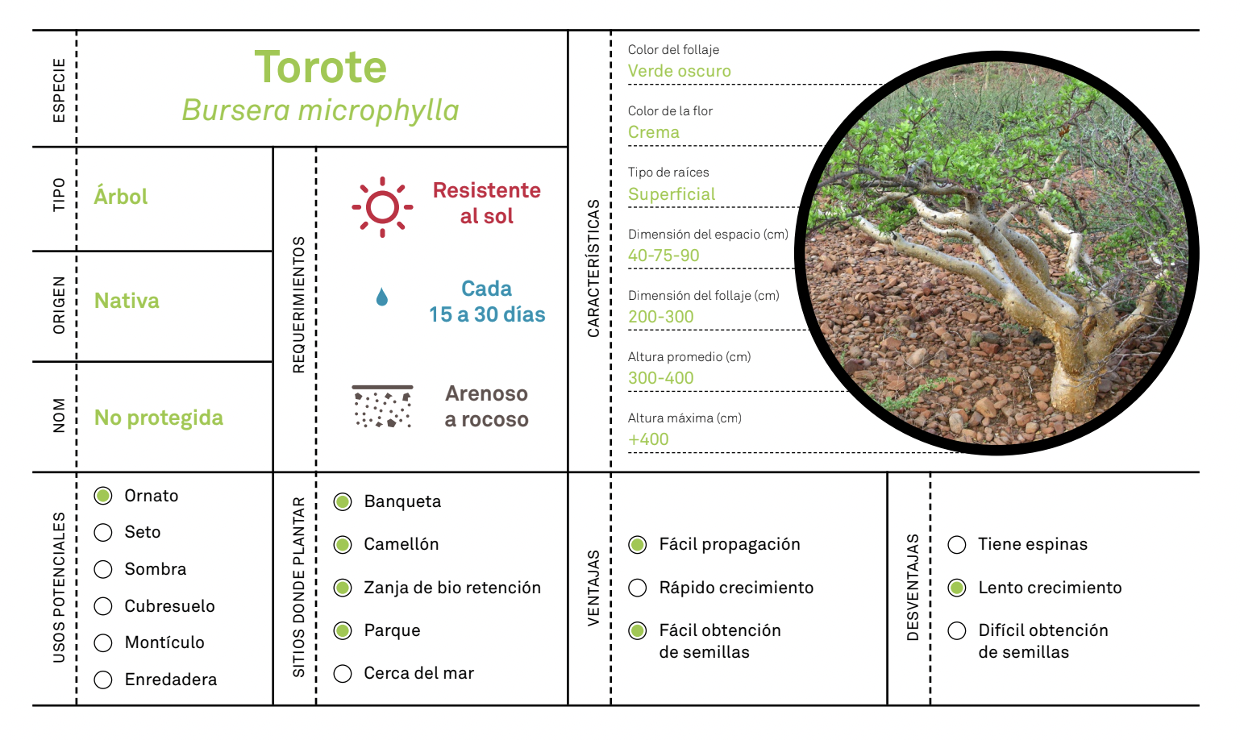
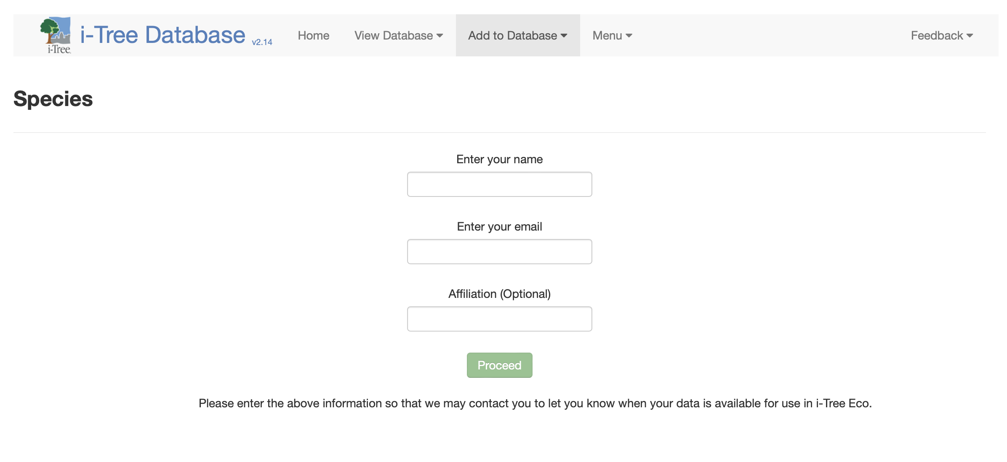
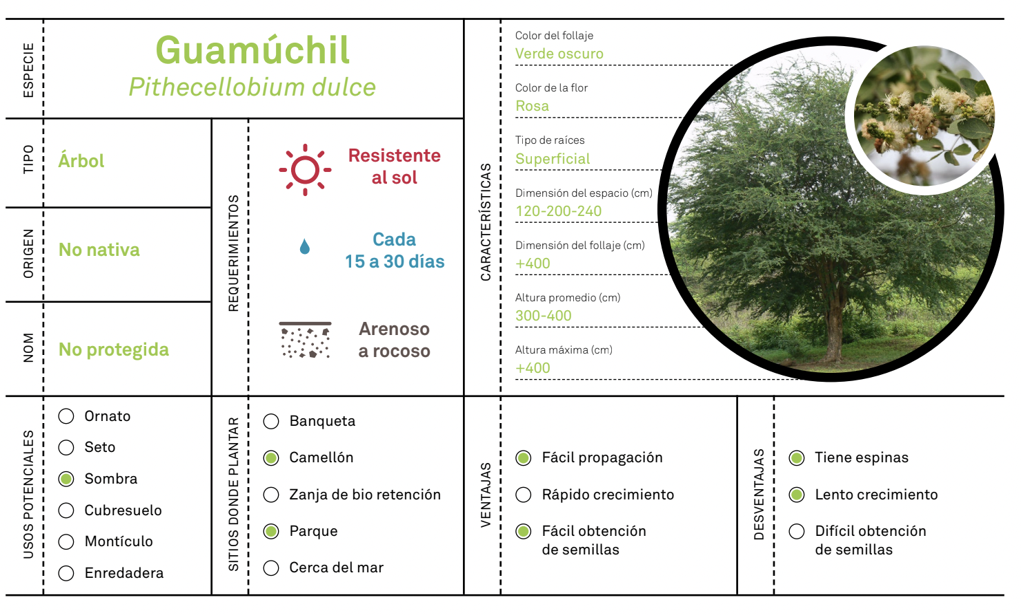
Planned actions:
S1: With the use of I-tree canopy, find areas with the greatest bare soil, which be potential areas to OU.
S2: Verify that the native are integrated into the I-Tree Data Base.
S3: Through the use of I-tree Eco, carry out a complete inventory for each urban oasis that is created at the beginning of its installation and subsequently every 2 years
Key partners:
Urban Oasis partners: Ecology Project International Mexico and Urbaneria
Others: Town hall staff, USFS IP, Young volunteers (Californios Verdes), Academic specialist in native vegetation
Resources needed:
Time
Financing
Volunteers
Obstacles or challenges:
Restrictions due to COVID
Absence of species in the data base
Rotation of volunteers

Slide 3
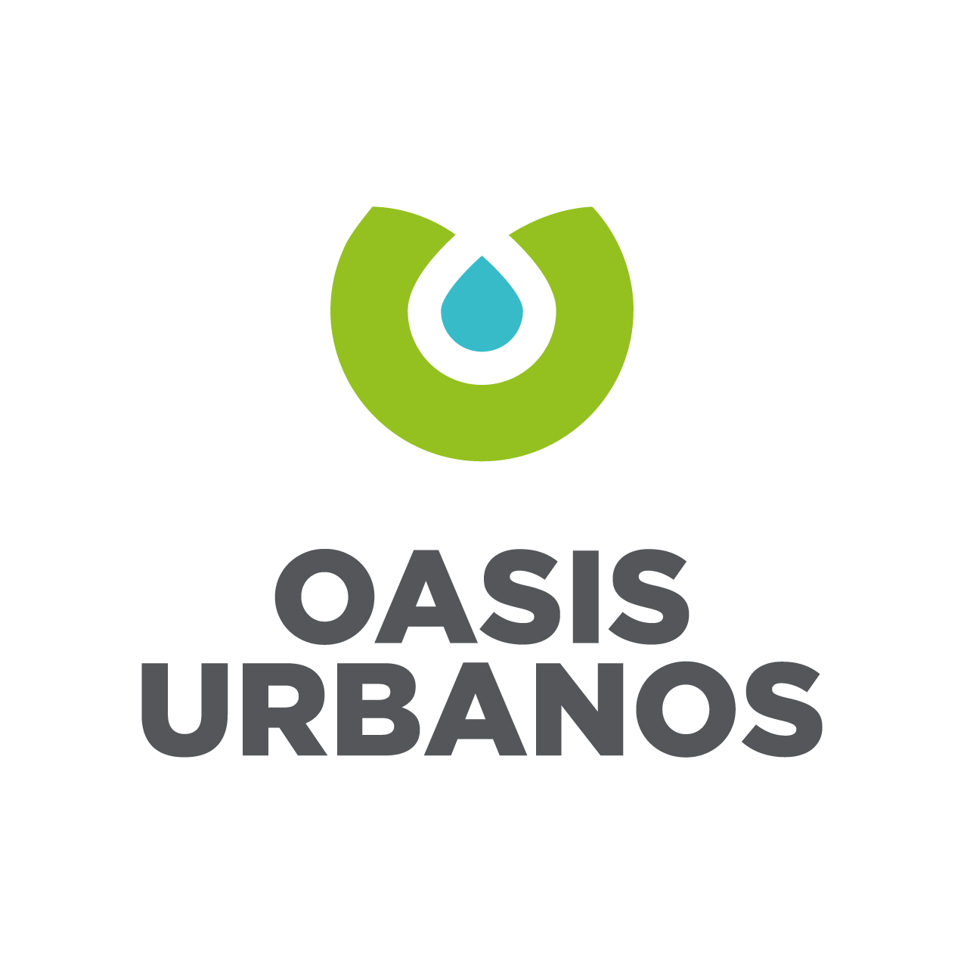
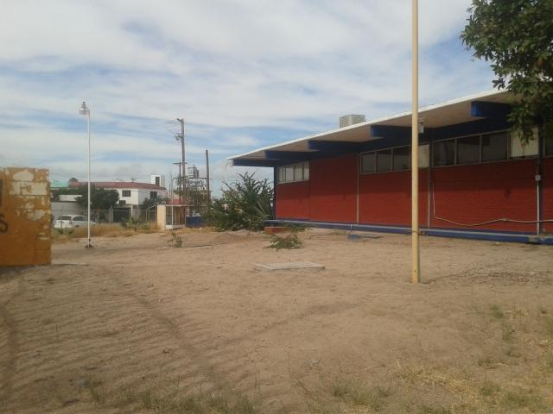



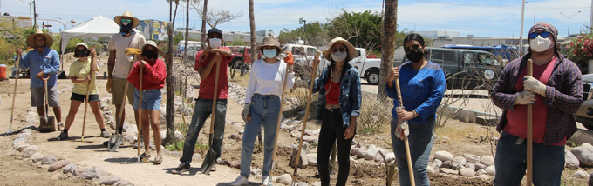
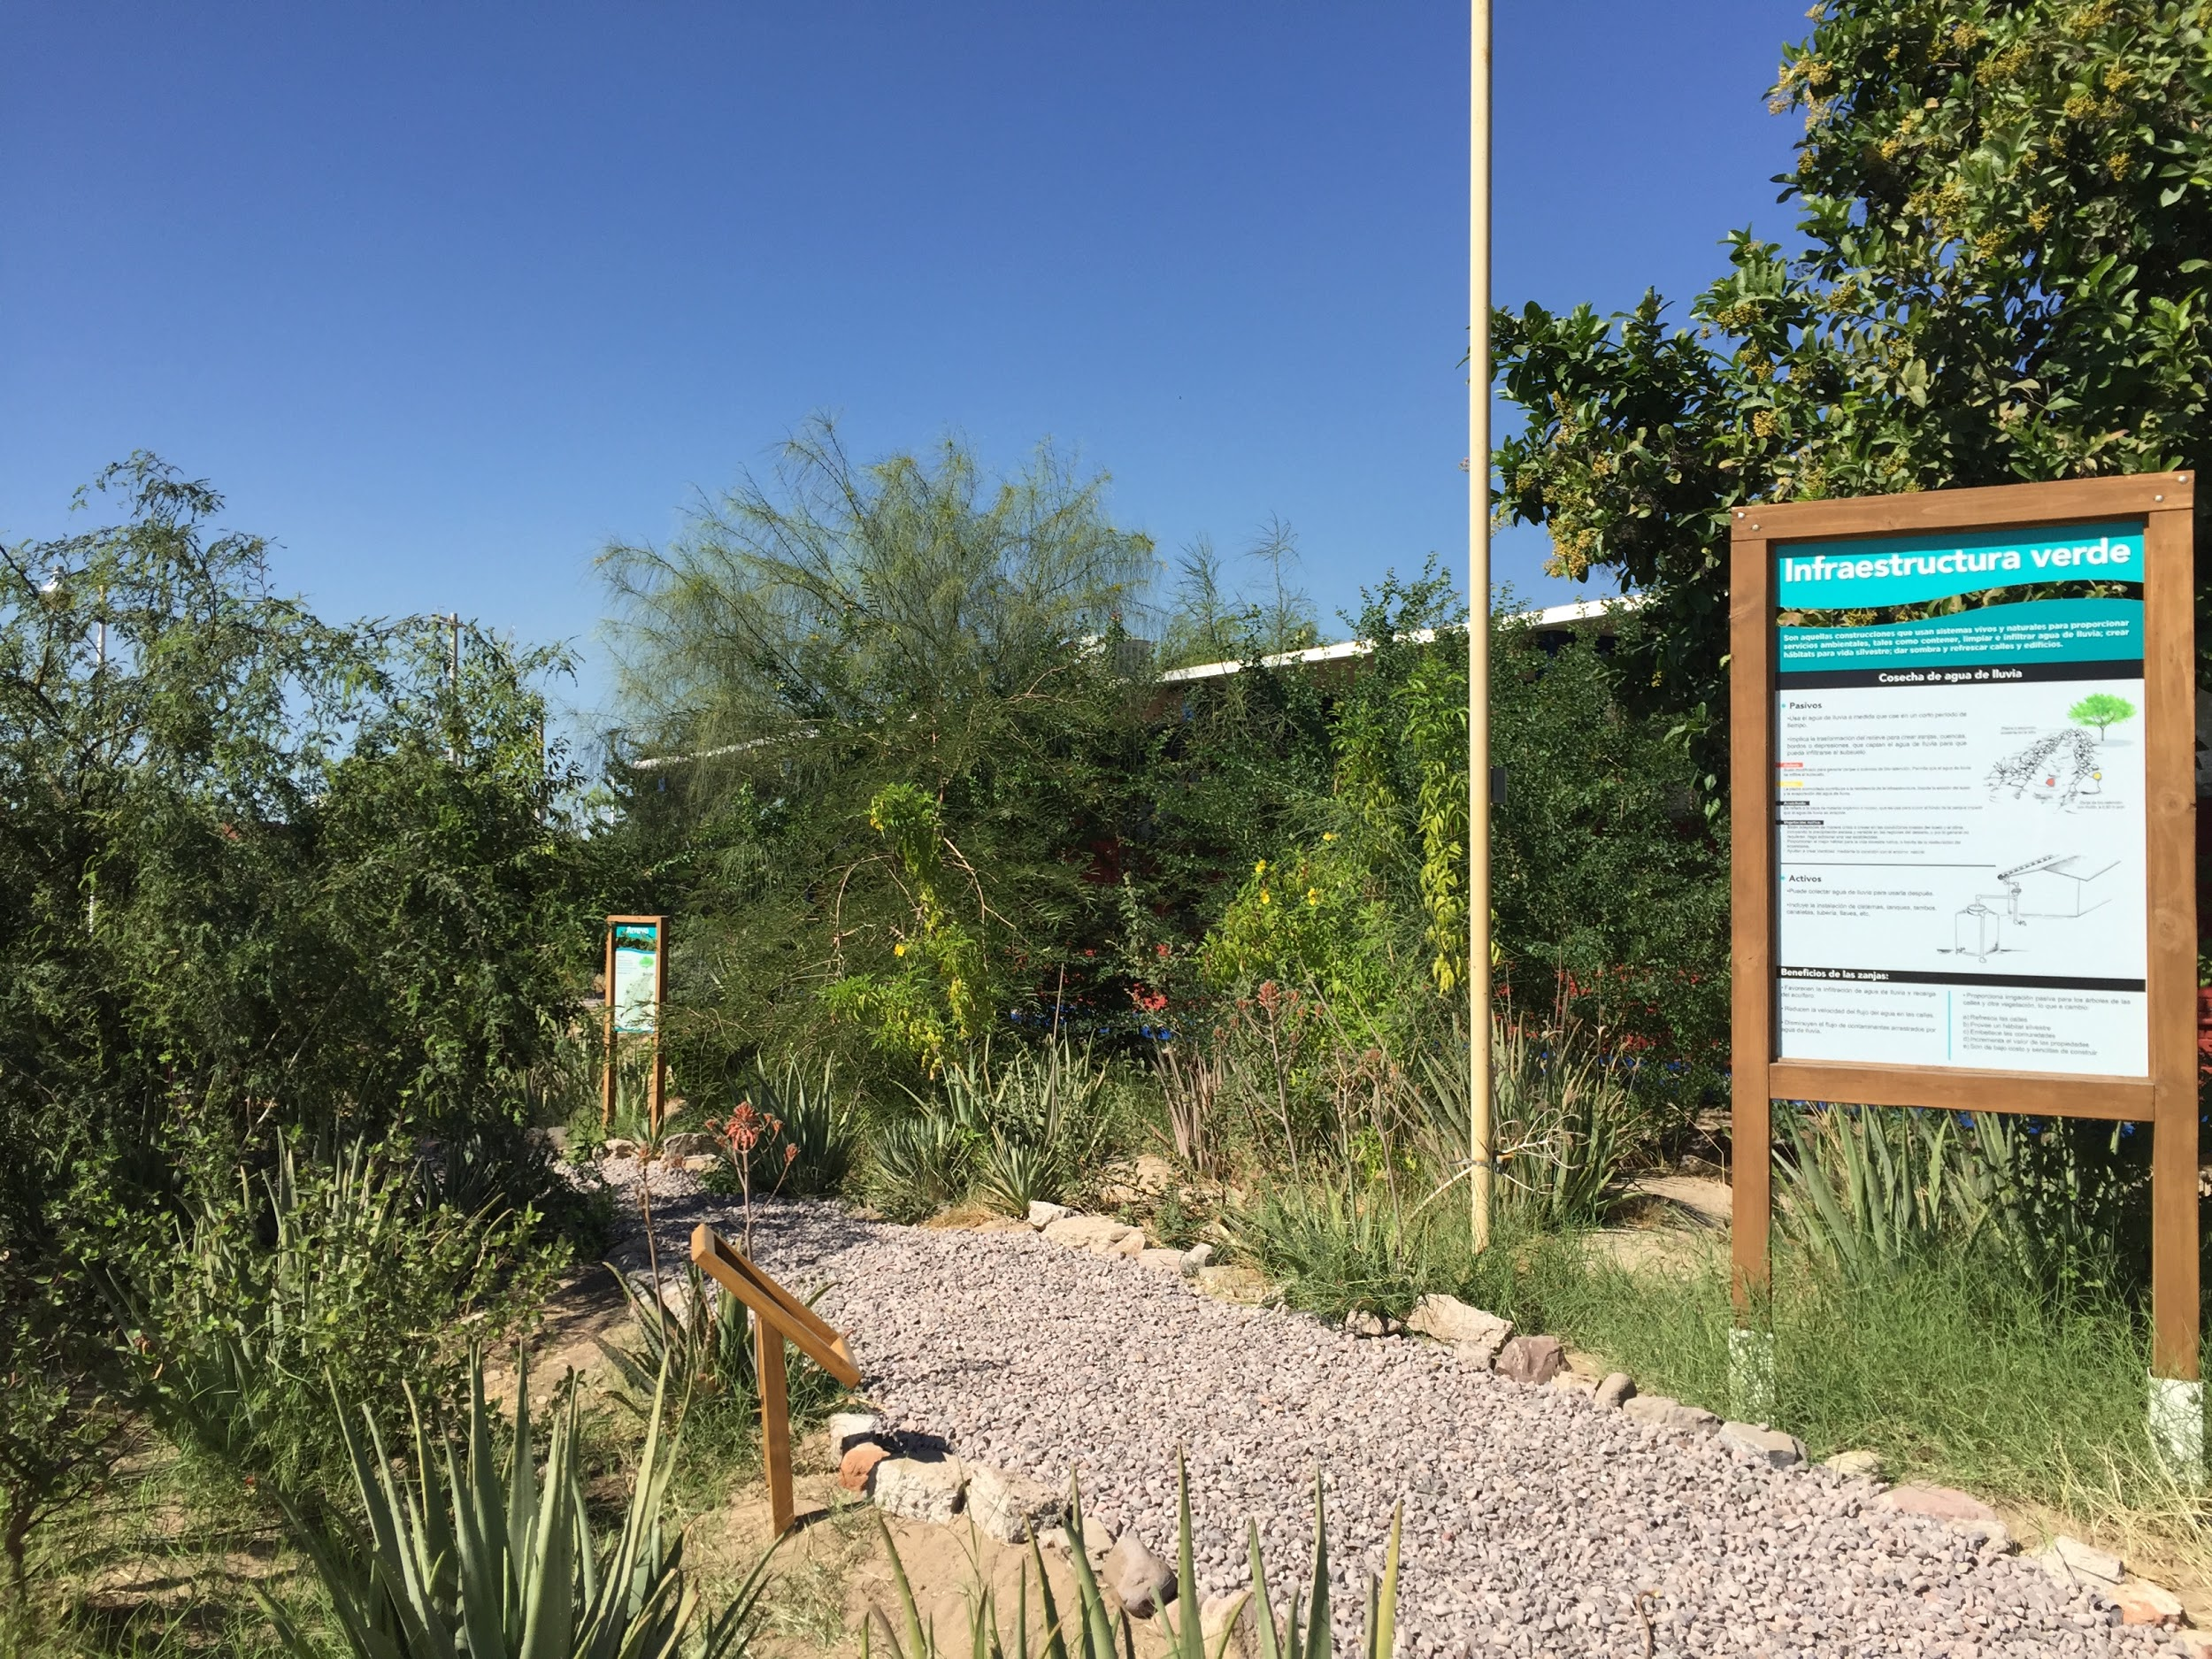
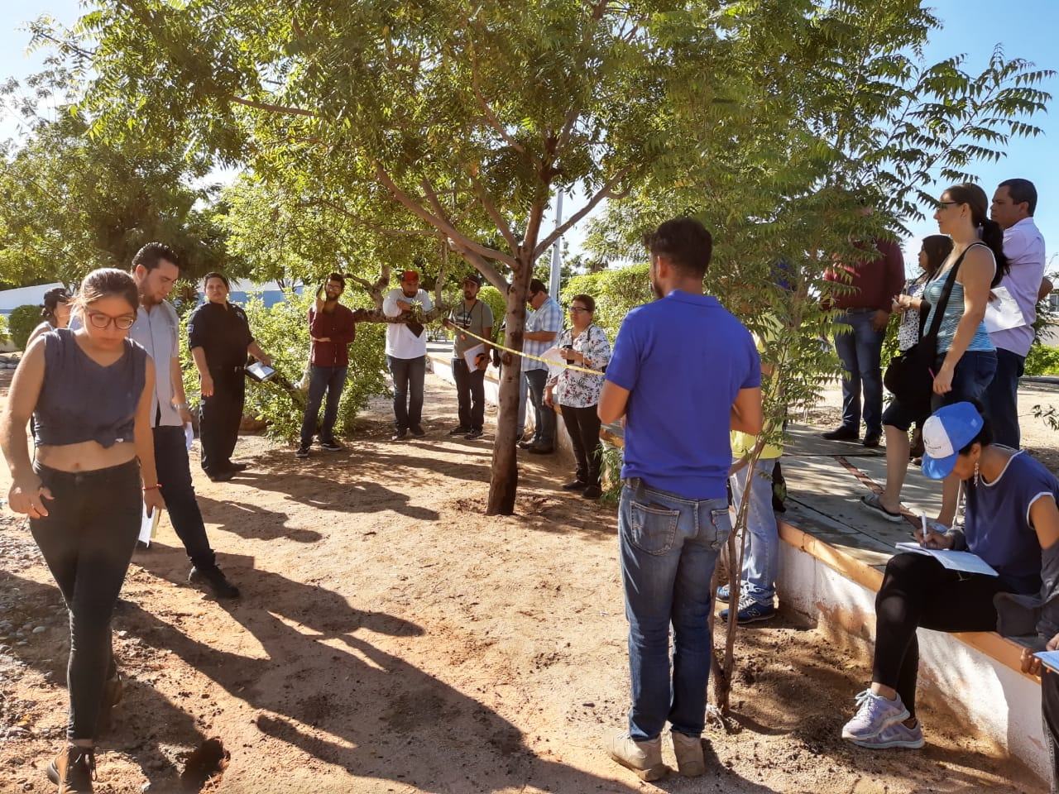
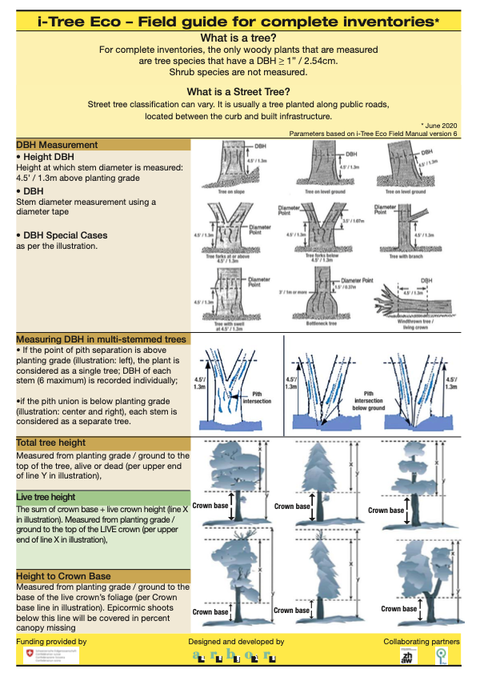
Planned actions:
S1: With the use of I-tree canopy, areas with the greatest bare soil, which be potential areas to OU.
S2: Verify that the native are integrated into the I-Tree Data Base.
S3: Through the use of I-tree Eco, carry out a complete inventory for each urban oasis that is created at the beginning of its installation and subsequently every 2 years
Key partners:
Urban Oasis partners: Ecology Project International Mexico and Urbaneria
Others: Town hall staff, USFS IP, Young volunteers (Californios Verdes), Academic specialist in native vegetation
Resources needed:
Time
Financing
Volunteers
Obstacles or challenges:
Restrictions due to COVID
Absence of species in the data base
Rotation of volunteers

