Slide 1
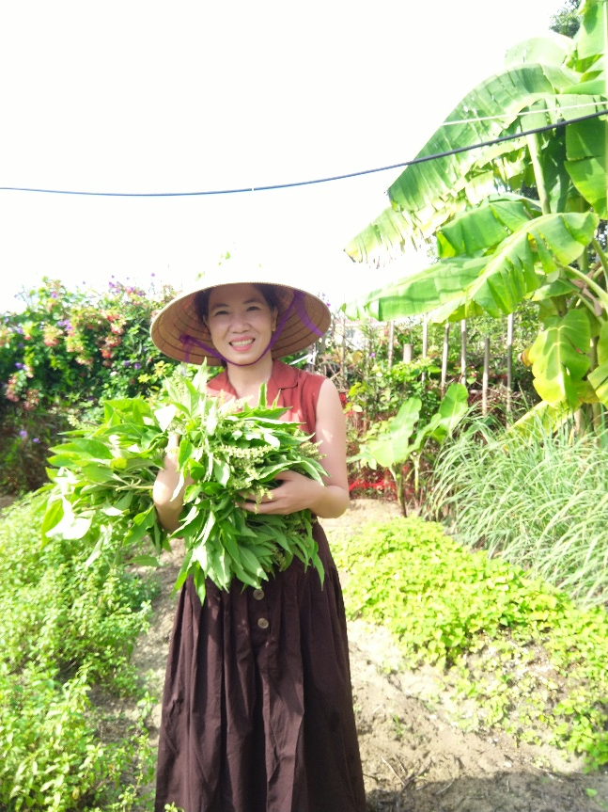
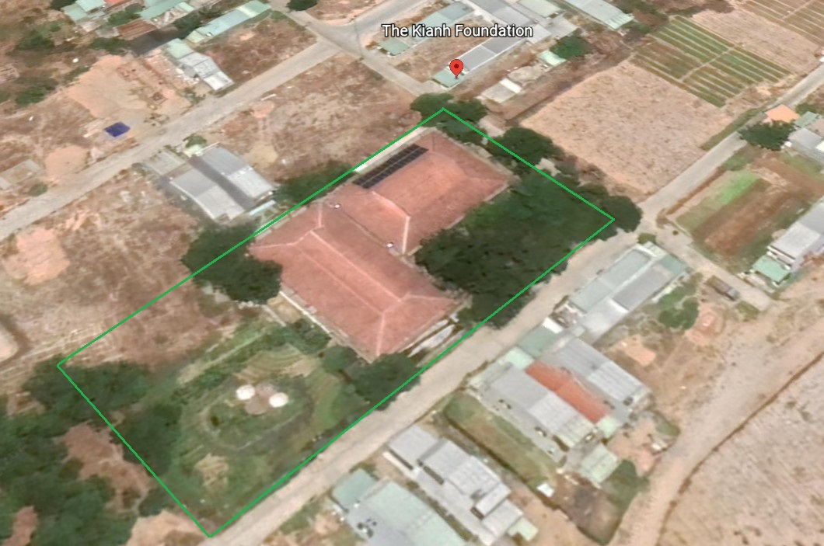
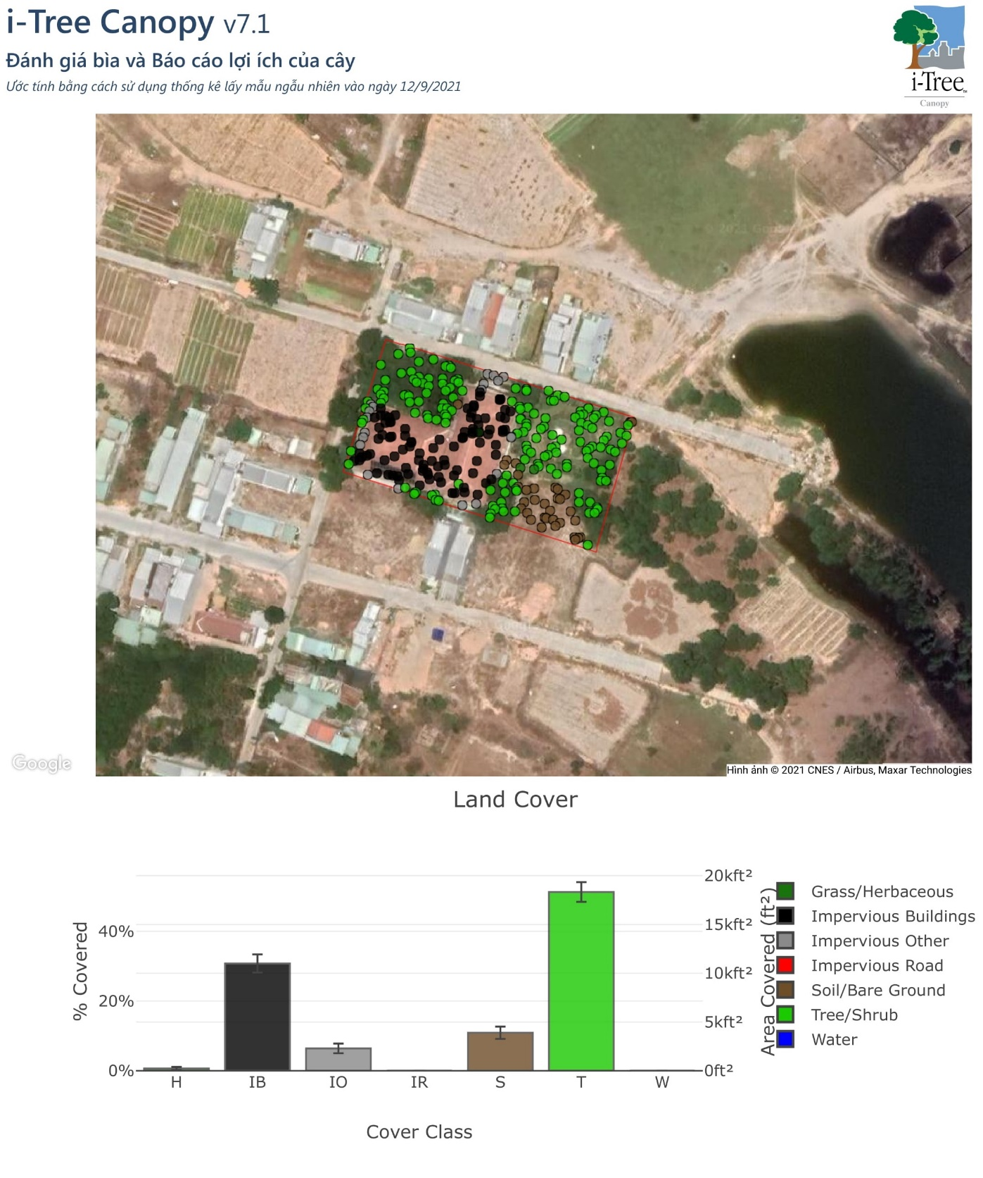
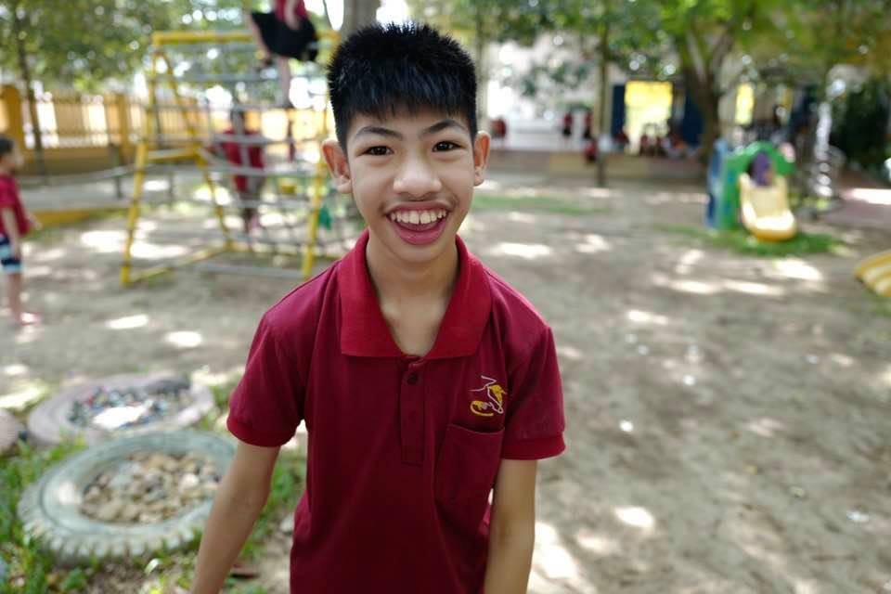
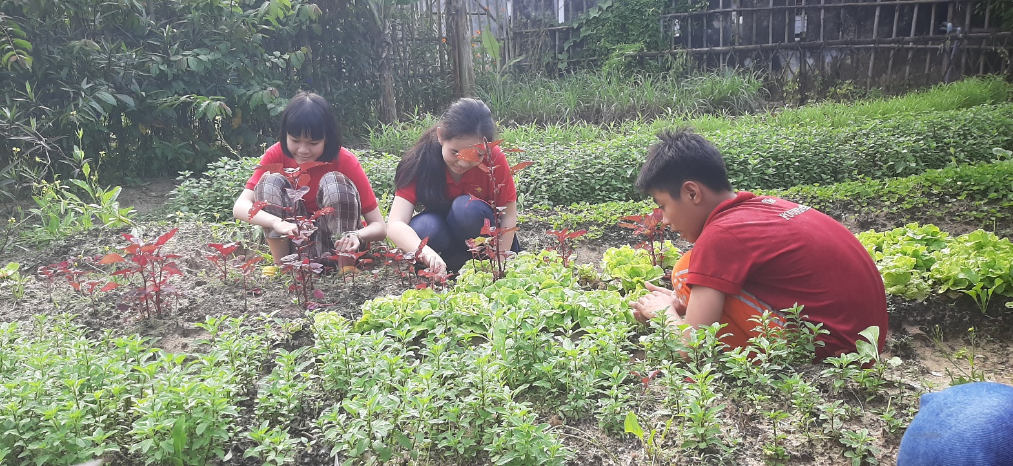
International i-Tree Academy i-Tree Action Plan
DO LE TO QUYEN
Quang Nam- Vietnam
The Kianh Foundation
Your Photo
1. Objective for the i-Tree Action Plan: Teaching students about trees and their benefits and other relevant matters, with the support of innovative input from i-Tree.
2. What issue(s) or opportunity will your plan help address? Students will get involved with trees in ways that are significant and relevant to them, and learn more about them through a variety of activities. They will learn that they, like all young people, should be aware of the necessity of gardens and trees on this, our only living earth.
3. What i-Tree tool(s) do you plan to use?
I will continue to study more about i-Tree Canopy and Eco so that I can assist our plan to work.
The Kianh Special School

Slide 2
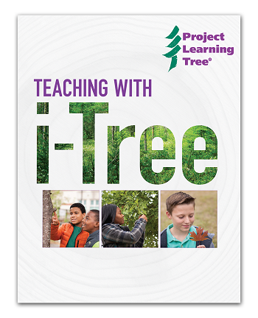
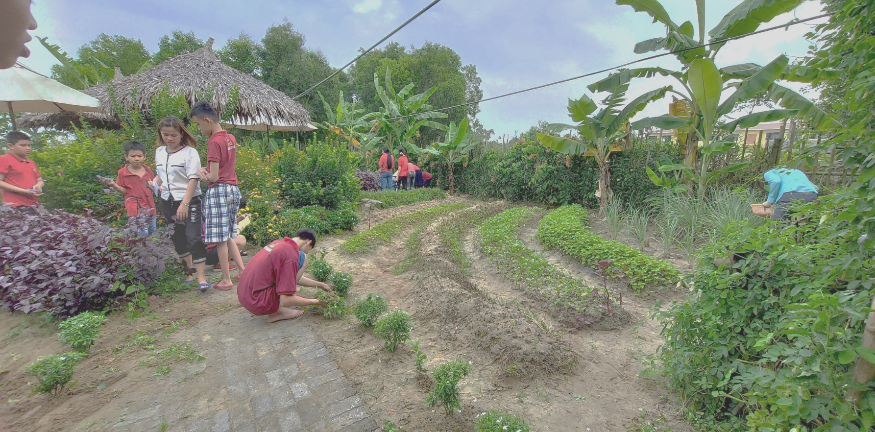
Briefly describe planned actions or next steps
- To introduce how the i-Tree tools work for quantifying trees’ benefits analysis and assessment to students who are able to learn or anyone who wishes to learn more. (Eg. Create signs or images that interest the students at our school)
- Identify the number of trees in the school to be surveyed (students can get involved in this) and using i-Tree Eco for processing data. This will be used as an interesting example for our presentation on tree benefits.
- Collect supportive data and relevant resources, and combine these with lessons for students to learn in conjunction with scientific analysis of i-Tree.
Who are key partners?
We, the school management and the teaching team, will work together for the practical outcomes.
What resources are needed?
-Resources in visual form about trees and trees’ benefits (presented to children, students or young people) would be great for our work.
- There could be some data of specific trees in Vietnam to be looked for in i-Tree’ s library.
- I-Tree support and resources in general.
What obstacles, challenges do you anticipate?
We do not have much expert knowledge about tree science and fear some limitations in our knowledge. However, we have a deep understanding of the importance of trees in our world and hope that our passion in this area will compensate for any gaps in our knowledge.
We were supported to create a large and beautiful organic garden at our school, which is the perfect outdoor classroom. A huge number of ideas and themes from this garden are taught and applied in so many of our lessons
Learn about a wide variety of plants
Learn their different colors
Which ones can be cooked and how to cook them
Literacy and communication lessons based around the plants and flowers;
Having fun
Much emotional therapy…from their outdoors sessions
Teach students how to live in respect of nature
Building a love of nature, and
Having a desire to protect nature in our daily behaviour and practice.
HOW THE PLAN IMPACT ON THE STUDENTS?
With proven lessons derived from our work, we believe that the more meaningfully practical exposure to the world a child has, the more functional a child will become in these aspects, and overall.

